Slide 1
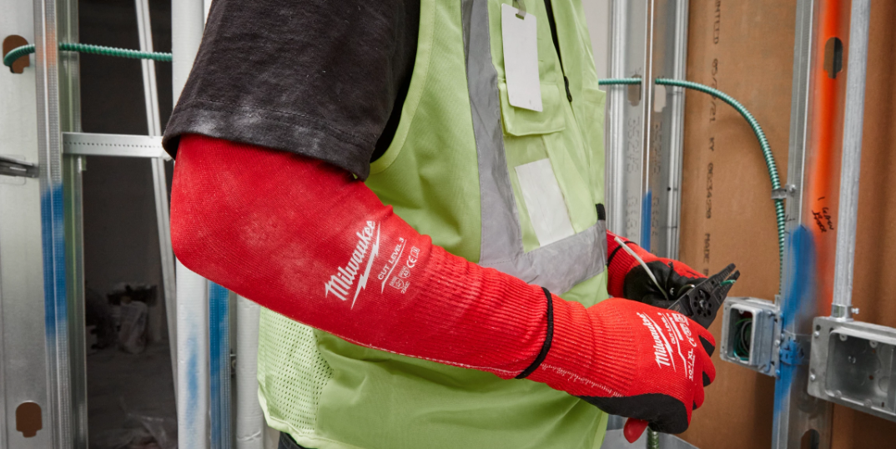
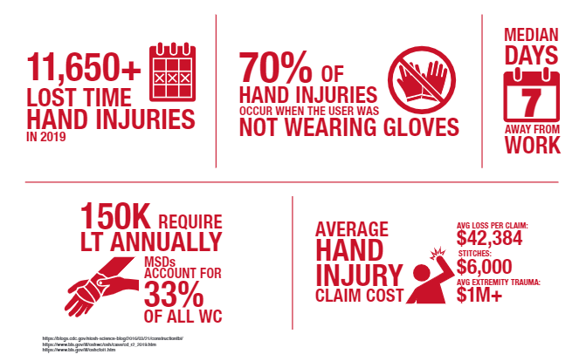
PPE SAFETY – Hands / Arms
Know the risk Factors:
PPE is known as the last line of defense based on the Hierarchy of Controls – yet it is vital to all Trade Professionals due to unknown hazards they are subjected to during operational tasks. Laceration incidents attribute to around 27% of all incidents that require medical care based on BLS statistics. Hands and Arms are the areas of the body most impacted due to lacerations. Hand and Arm PPE have many different protective measures within design features that include protecting the hands / arms from lacerations, chemical burns, vibration exposure, punctures, abrasions, knuckle fracture, etc. – Gloves that are the improper size can also be additional hazards, too tight, or improper protection. Understanding proper fit and the type of hand / arm PPE will help you work safe and increase comfort while engaged in your operations.
Please discuss this with your crew and ask them to identify 4 hazards and precautions associated with PPE safety focused on Hand and Arm protection, then flip the page over and see if they identified the same things as we did. Challenge them to identify the hazards before reviewing them on page 4.
1

Slide 2
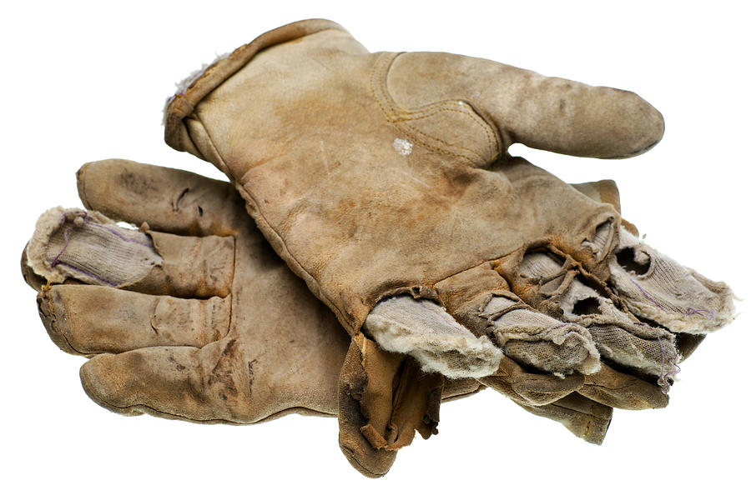
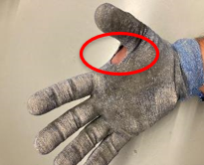
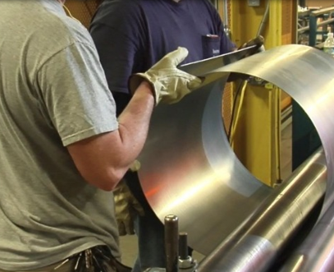
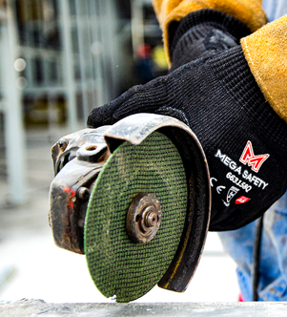



Topic: PPE Safety - Hand and Arm’s
Gloves with holes in them should be removed from operational use to avoid injury.
Inspect gloves prior to use – avoid using gloves with exposed skin.
Exposed skin should be protected when handling sharp materials – recommend wearing cut-resistant sleeves during material handling operations
Wear the correct gloves for specific hazards / avoid creating a hazard.
2

Slide 3
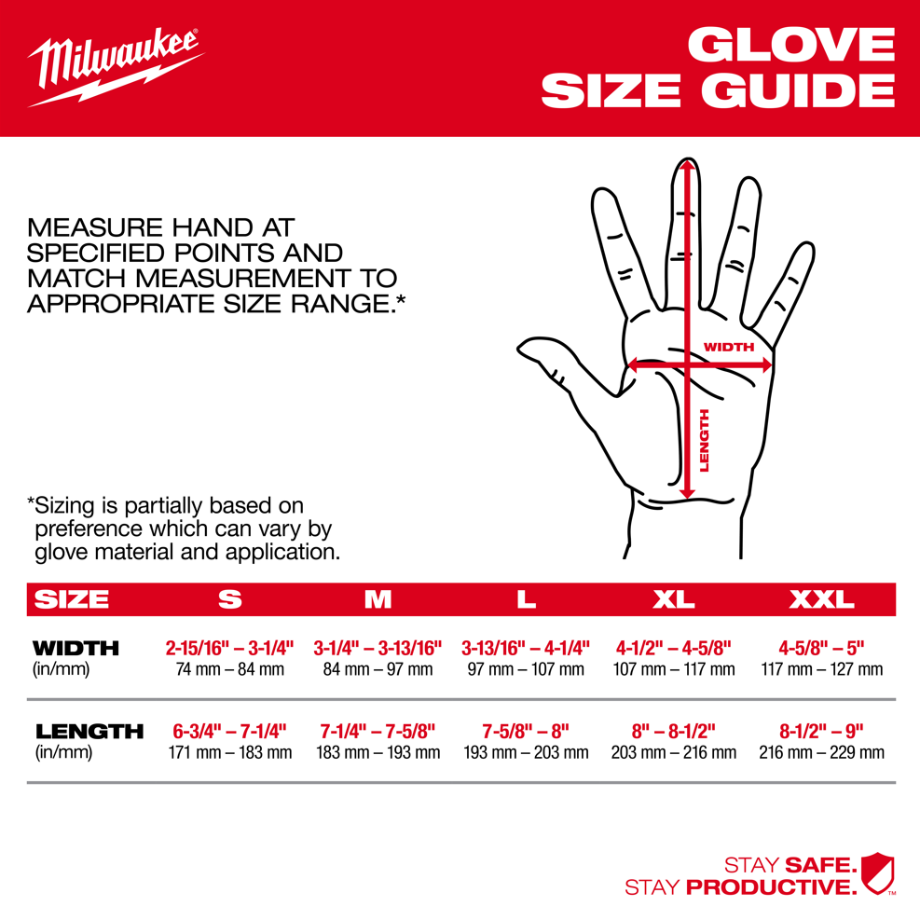
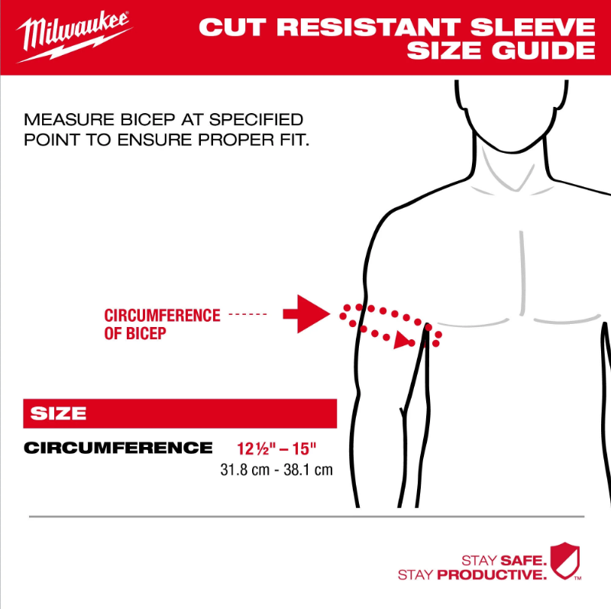
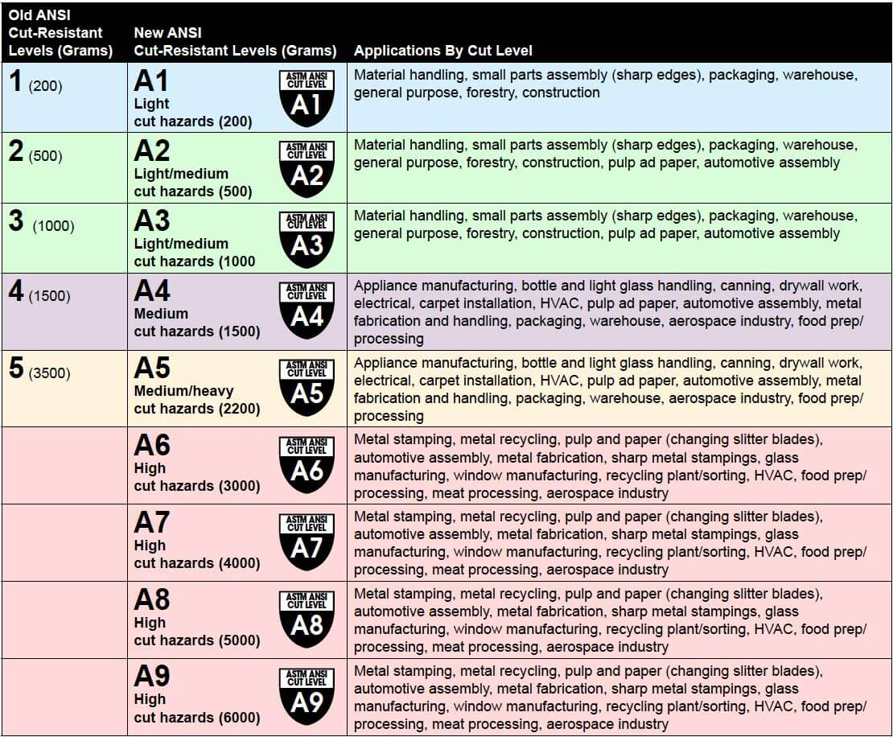
Recap
Topic: PPE Safety – Hands and Arm’s
Wearing the correct size of gloves is important as gloves the wrong size can create hazards.
The correct size of sleeves will increase use due to comfort.
Going cordless – removing cords and improving the reduction of fall and shock hazards. NO GFCI’s needed
3

Slide 4
Recap
Project: |  | Supervisor
Date:
Topic: PPE Safety – Hands and Arm’s
Hazards | Precaution
Laceration Hazard | Understanding the type of operation and hazards that exist withing the operation are crucial. Lacerations can be prevented with cut resistant gloves and sleeves. Inspect your PPE prior to use, dispose of PPE with holes in it, use the right type of PPE to protect yourself. Cut resistant doesn’t mean cut-proof. Do you need a different type of glove that matches the hazard? Check and verify types of gloves vs the ANSI standard for protection. Wear cut resistant sleeves when handling sharp materials or products that have a laceration hazard.
Proper Fit | Gloves that do not fit correctly can cause additional hazards instead of protecting your hands. Fingers that are to long and allow additional material that hangs past the fingers can get caught in rotating accessories (blades / bits) pulling your fingers into the tool. Gloves that are too tight can cause finger numbness (reducing ability to hold onto materials) – Don’t be afraid to say something!
Chemical Burn | Check the Safety Data Sheet of any chemical or product that can cause skin irritation or chemical burns to ensure proper gloves are used for the operation. Understand if your gloves offer 100% hand protection and are designed for use with chemicals. Manufacturers specifications can be found with the package of most PPE or online. Be cautious when removing gloves to avoid getting materials on your bare skin and possibly in your eyes. Clean up per the SDS sheet instructions..
Cross Contamination of Gloves | Cross contamination hazards can create health and quality hazards. Beware of possible specification that require cross contamination procedures / specifications to avoid causing a quality control incident that can lead to rework. Rework can lead to injury incidents. Avoid using gloves that have been saturated or absorbed any chemicals / materials. (Example – tie wire that has fish oil on it to prevent rusting can cause an allergic reaction to someone allergic to shellfish) / chemicals that are flammable.
Crew Member’s Names
4

